Slide 1
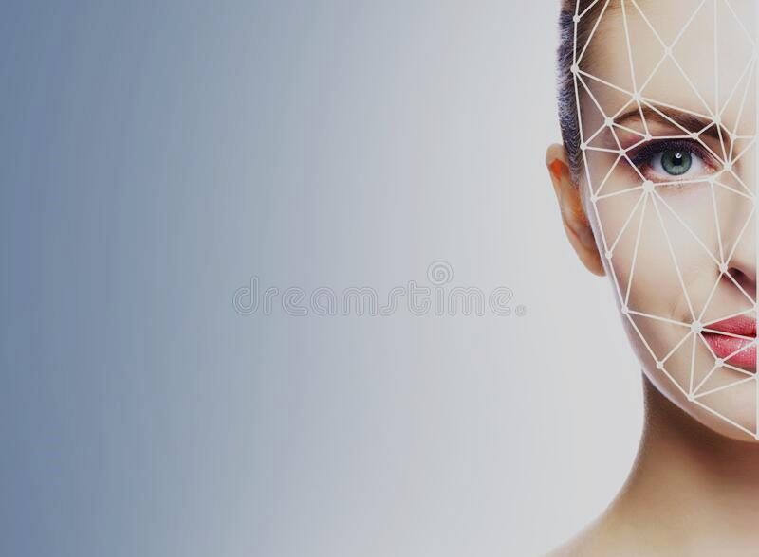
SMART SECURITY SYSTEM
SMART SECURITY
SYSTEM

Slide 2
Presented by
Shivani Patil 16UIT11041XX
Vinay Sakhare 16UIT12046XX
Kanishk Shedsale 16UIT12049XX
Akshaykumar Patil 16UIT12037XX
Rutuja Prabhudesai 16UIT11044XX

Slide 3
Abstract
This project gives an outline for an automatic system to control and secure specific area, based on digital image processing with the help of Internet of Things and AI.
The system consists of a sensor, digital camera, database and the smart phone.
Sensors are placed in the specific area which alerts camera to start recording the activity in that area.
Then video is than divided into frames.
Image analysis is performed to detect and recognize and match the image with the stored dataset of the authenticated people.
If the image captured does not match with the dataset then an alert message is send to the owner of that area.

Slide 4
Problem Statement
To provide smart security system to the specific area using IoT (sensors) and AI (face detection).

Slide 5
Problem Definition
The sensors will sense the motion in the specified area and activate the cameras. This cameras will record the activity and send it for further image analysis. If the human detected from that image does not match with the authenticated people then it generates an alert message as well as alert alarm.

Slide 6
Objectives
To sense the motion in the specific area.
To capture the image and recognize the person.
To generate an alert for unknown people.

Slide 7
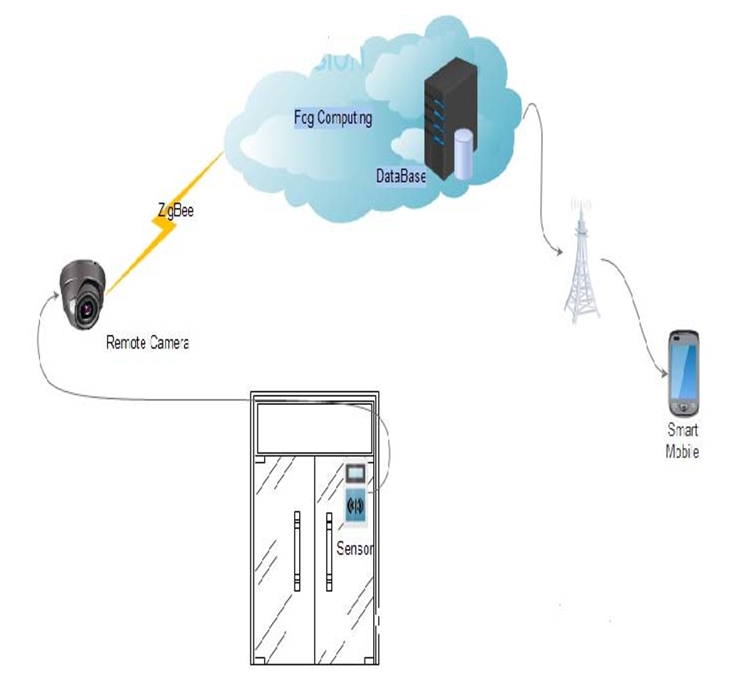
Architecture Diagram

Slide 8
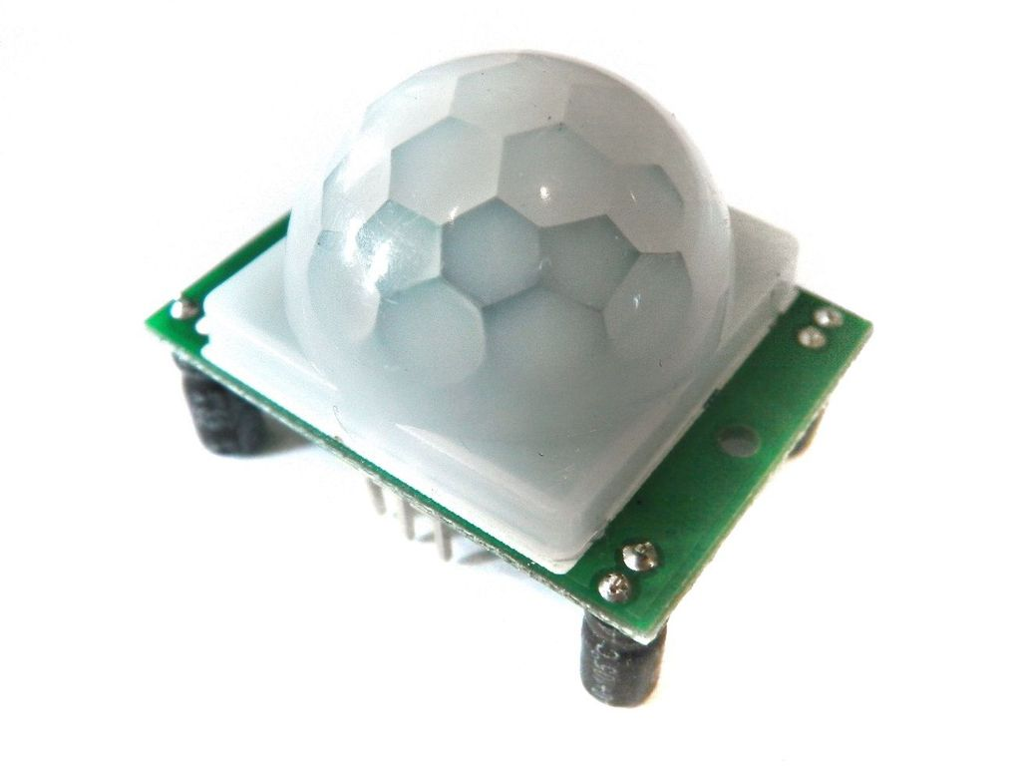
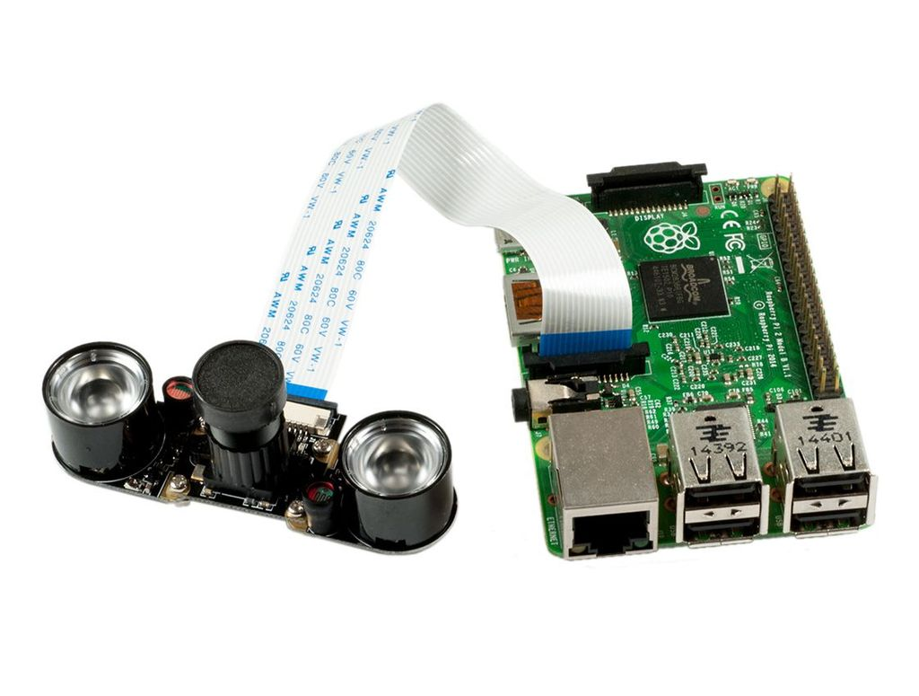
Motion Sensors
Camera

Slide 9
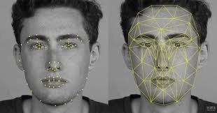
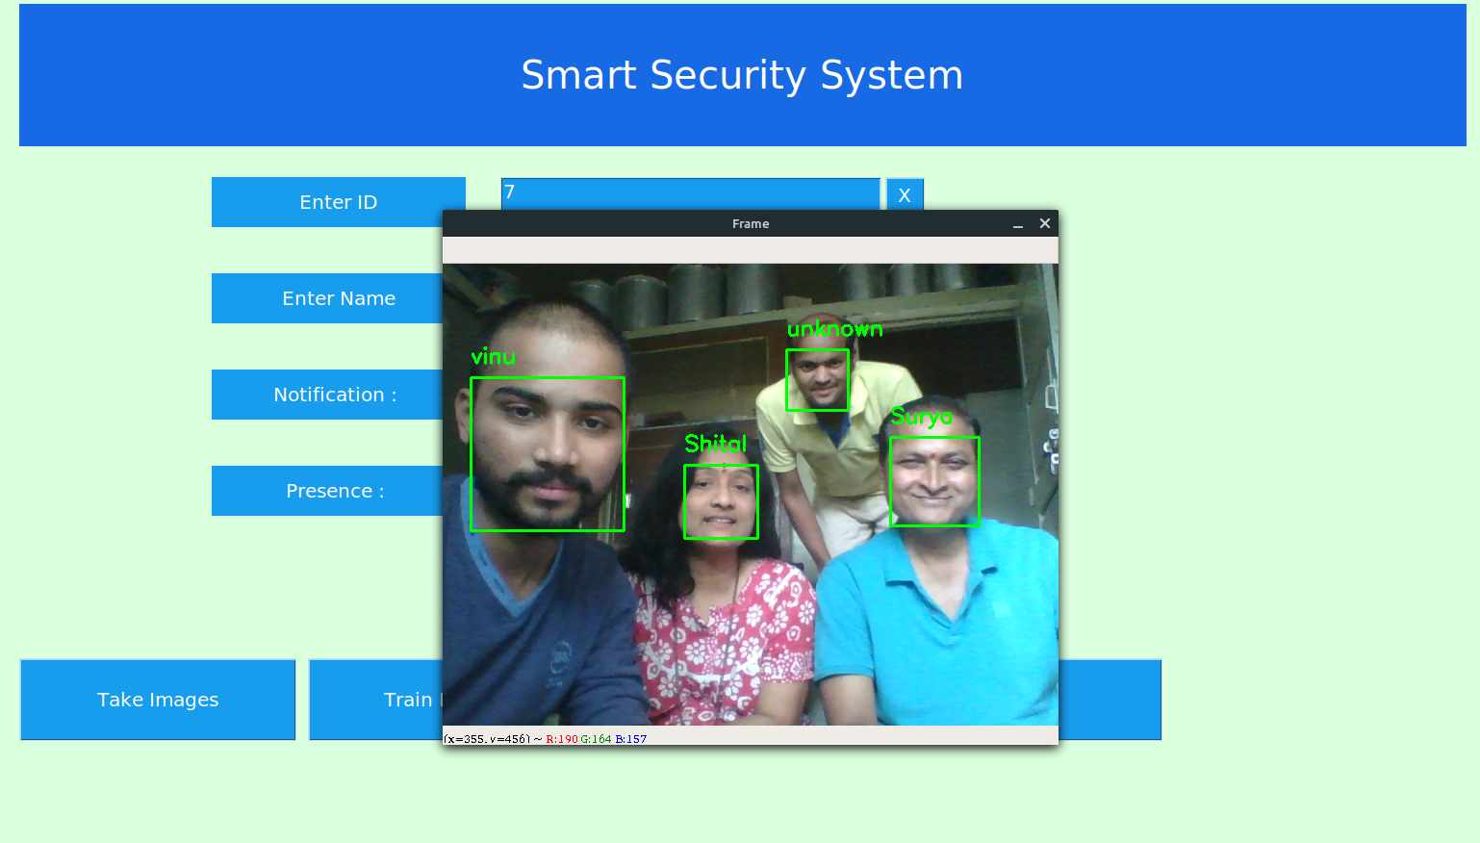
Video Segmentation
Image Analysis
Image Recognition

Slide 10
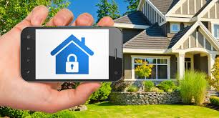
Generating an alert message and alarm

Slide 11
Literature Survey
IoT based Home Security through Digital Image Processing Algorithms(2017)
Detection of human-being and non-human object from image and video sequences (2017)
Deep Neural Network for Human Face Recognition (January 2018)
Face Recognition and IoT Based Smart Lock Access System (2018)
A Smart Security System with Recognition (December 2018)
Smart Home Management System Based on Face Recognition Index in Real-time (2019)

Slide 12
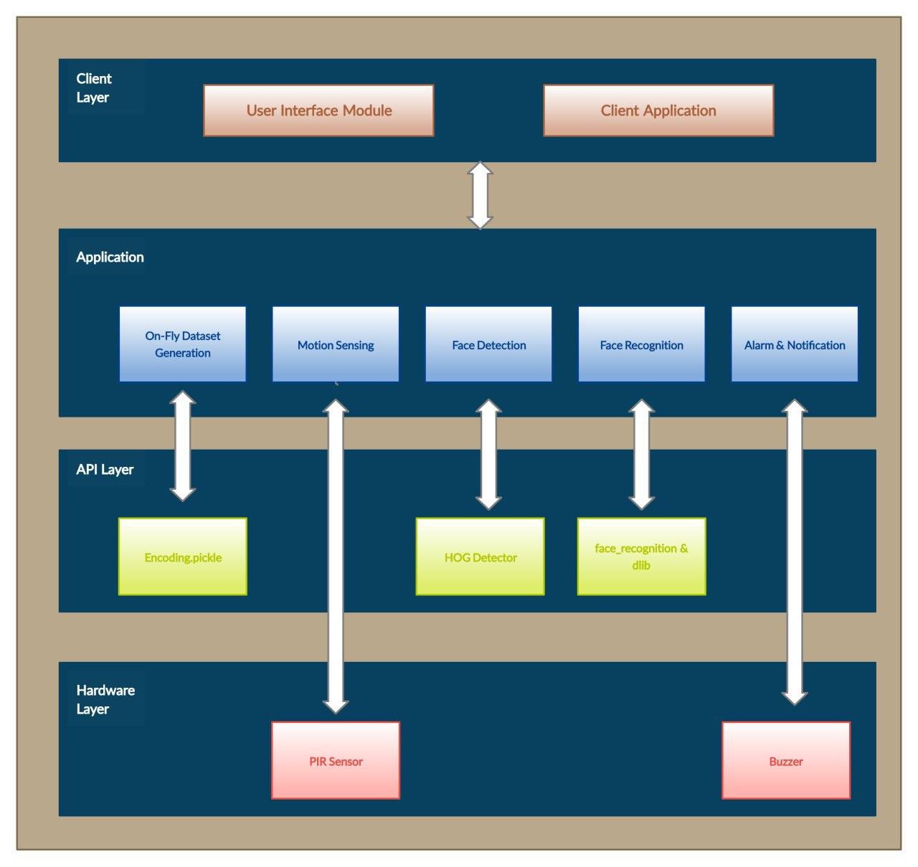
System Architecture

Slide 13
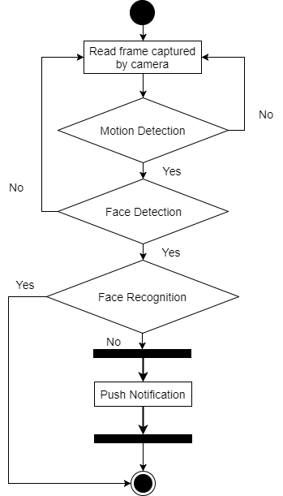

Slide 14
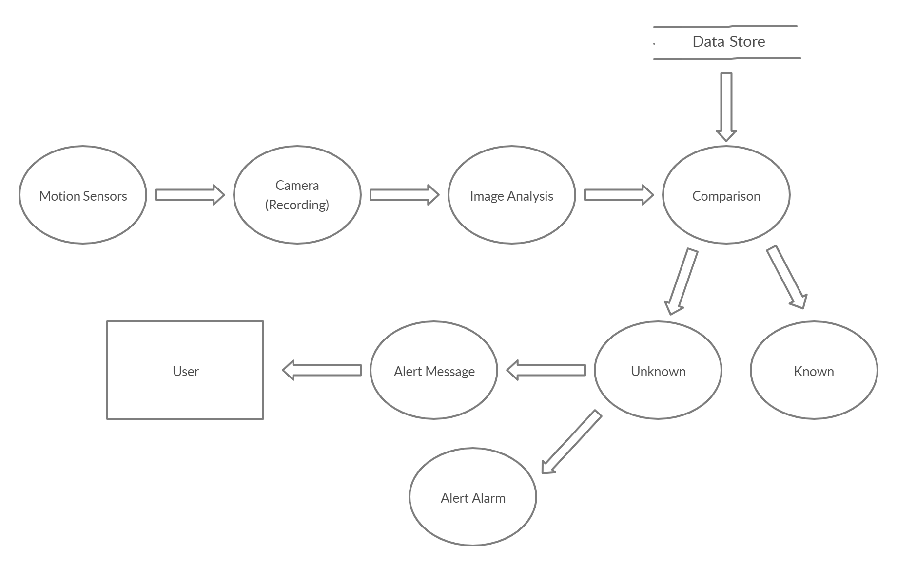
Data Flow Diagram

Slide 15
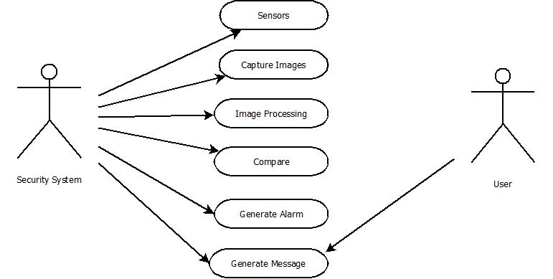
Use Case Diagram

Slide 16
References
Face Recognition System Using IoT (November 2017) SandeshKulkarni, MinaksheeBagul, AkanshaDukare, Prof. ArchanaGaikwad
Deep Neural Network for Human Face Recognition (January 2018) Dr. PriyaGuptaa, NidhiSaxenaa, MeetikaSharmaa, JagritiTripathia
Face Recognition and IoT Based Smart Lock Access System (2018) Numitha M N1, Taha Noorain1, Amulya S Patil1, Navyashree H V1, Ms. Nagalakshmi T S2.
A Smart Security System with Recognition (December 2018) Trung Nguyen, Barth Lakshmanan and Weihua Sheng
Smart Home Management System Based on Face Recognition Index in Real-time (2019) Shakir Fattah Kak ,FirasMahmood Mustafa

Slide 17
Applications
Criminal identification : If FaceTech can be used to keep unauthorised people out of facilities, surely it can be used to help put them firmly inside them.
Security companies are using facial recognition to secure their premises.
IoT benefits from facial recognition by allowing enhanced security measures and automatic access control at home.
Bank Services : Banks are using this product of Artificial intelligence as security measure to detect any suspects entering without being identified.

Slide 18
THANK YOU

